Slide 1
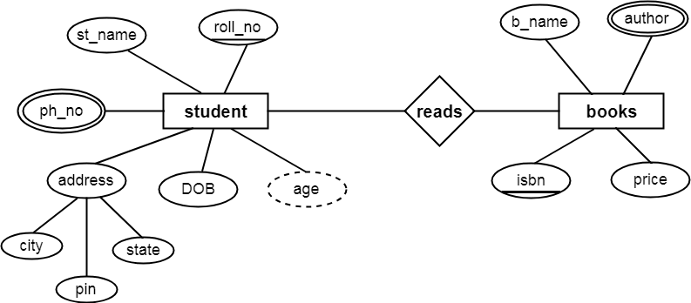
ER MODEL
Module Tutor
Ibtisam Mogul

Slide 2
CONTENT
ER MODEL DEFINITION
ENTITY
ATTRIBUTES
RELATIONSHIP
SYMBOLS
CARDINALITIES

Slide 3
Database Design
Requirements gathering and specifications
provide you with a high-level understanding of
the organization,
its data, and
the processes
that you must model in the database.
Database design
involves constructing a suitable model of this information.
Types of DB Design
Conceptual Design/Logical Design- ER model
Physical design- Relational model
Notes:
https://www.coursehero.com/file/18375486/Session07-upload-2/

Slide 4
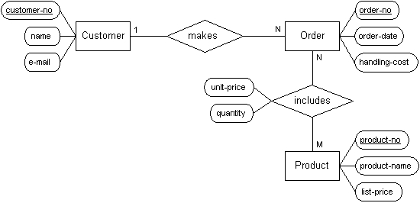
Conceptual Database Design
Modeling the collected information at a high-level
without using a particular DBMS.
The most popular database design language is the
Entity-relationship model proposed by Peter Chen in 1976.

Slide 5
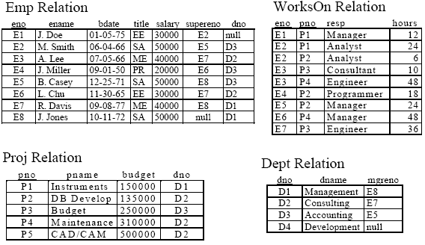
Relation Instances

Slide 6
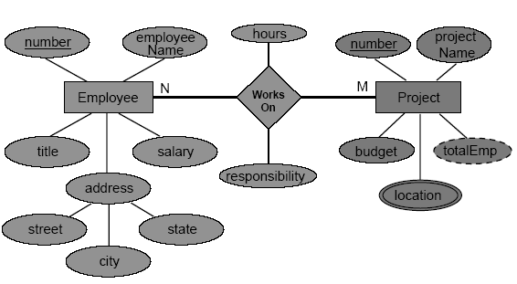
Relation Instances
Relation Instances
ER Model

Slide 7
ER Model Example

Slide 8

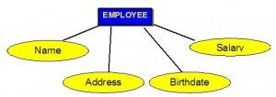
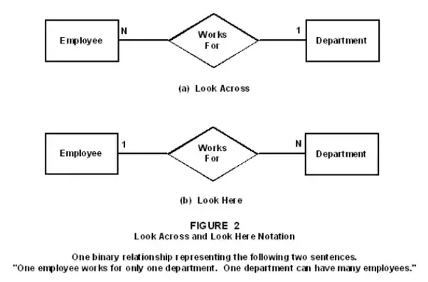
ERD Design Steps
Find the Entities from the problem statement
(Look for Nouns)
Find Attributes of each Entity
(adjectives -
describing features of entity)
Find the Relationships between the entities.
(Check for Verbs)

Slide 9
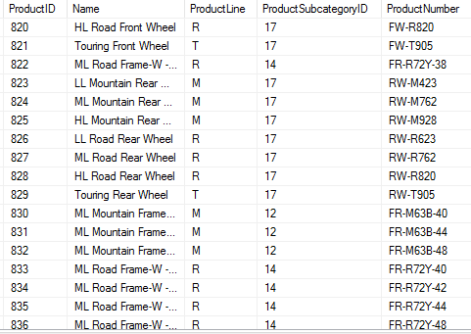
Entity Sets
An entity is an object that exists and is distinguishable from other objects.
stored as a record or a table row
Example: specific person, company, event, plant
An entity set is a set of entities of the same type that share the same properties.
stored as a relation or a table
Example: set of all persons, companies, trees, holidays

Slide 10
Entity
Entity
Represents a group of real-world objects that have properties.
Does not always have to be a physical real-world object such as a person or department,
it can be an abstract concept such as a project or job.
Stored as a relation or a table
Example: Person (Employee, Student), Department(Sales, Accounts D), Place(Hospital, University), object or event, Project
Entity instance
is a particular example or occurrence of an entity type.
Ex: entity : Employee(Eid, Ename, Esal),
entity instance (1, ‘Hulk’, 5000).

Slide 11
1. Representing Entity
Entity are represented by rectangles with the name of the entity in the rectangle.
Examples:
An entity name is normally a singular NOUN.
Person instead of People, Project instead of Projects
First letter of each word in the entity name is capital

Slide 12
2. Relationship
Relationship
is a set of meaningful associations/ connections among entities
Each relationship is given a name that describes its function.
Example:
Employee works on Project, Teacher teaches Subject,
Customer owns Account, Customer buys Cake, Doctor treats Patient
Relationship instance
is a particular occurrence of a relationship that relates entity instances.
Ex, WorksOn - relationship
Relationship instance : ‘Tony Stark' works on project ' End Game ‘
or (Tony Stark, End Game).

Slide 13

Representing Relationship Types
A simple relationship between two entities is represented as a
named diamond that connects the two entity types.
Name

Slide 14
Attributes
Property of an entity or a relationship.
Ex, entity Employee has attributes: name, salary, title, etc.
Represented as named ellipse
Rules:
attribute names begin with a lower case letter.
Each attribute has a domain which is
the set of allowable values for the attribute.

Slide 15
Attributes Types
Attributes may be
Simple/ Single valued attribute (ellipse)
Composite attribute (hierarchy of ellipses)
Multi-valued attribute (double ellipse)
Derived attribute (dashed ellipse)

Slide 16
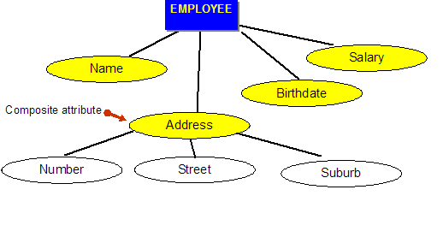
Attributes Types (contd…)
A. Simple attribute
contains a single part.
Also called atomic attributes.
Example, salary.
Represented by an ellipse
B. Composite attribute
consists of multiple components (subattributes) each.
Ex: address consists of (street, city and state)
Name consists of (?,?,?)
Represented as
hierarchy of ellipses
splitting of the ellipse
into component ellipses

Slide 17
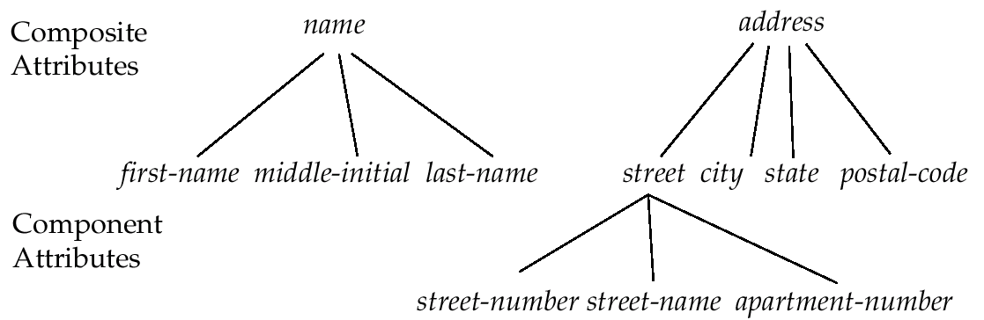
Composite Attributes
Attributes Types (contd…)

Slide 18
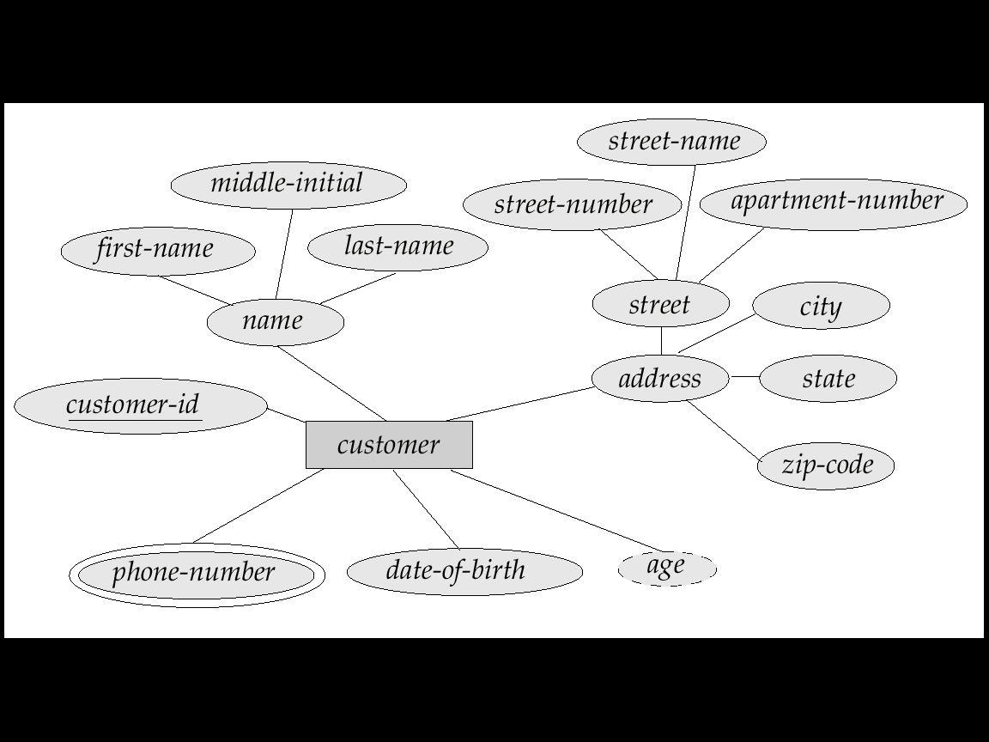
Single-Valued and Multi-Valued Attributes
A. Single-valued attribute
consists of a single value for each entity instance.
Example: salary
B. Multi-valued attribute
Attribute may have multiple values for a single entity instance.
Ex:
Telephone number =(home phone number, cell phone number, etc.)
Degree=(ATHE, BSc Computing, MSc-IT)
Represented as a double ellipse
Name

Slide 19
Derived Attributes
Derived attribute
Its value is calculated from other attributes
Its value is not physically stored.
Represented by dashed ellipse
Example :
Age can be calculated from DOB
Percentage obtained can be calculated from all Subject Marks
Price of a product can be found using
UnitPrice and QuantityOrdered
Name

Slide 20
Example

Slide 21
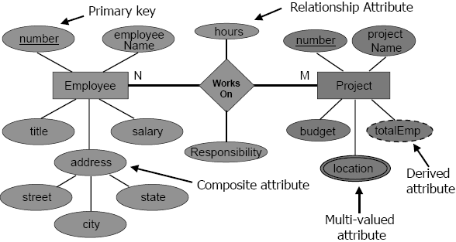
Attributes in the ER Model Example

Slide 22
Key
A key in a table, is an attribute or group of attributes that
creates identity
makes relationship with another table and/or
make a table more efficient.

Slide 23
a. Candidate Key
A candidate key is a minimal set of attributes that
uniquely identifies each instance of an entity type.
An attribute or a combination of attribute that identifies
the record uniquely but
none of its proper subsets can identify the records uniquely.
E.g. of Candidate Key
1 EmpId
2 EName, DOB
EmpId, EName . Is it a candidate key????

Slide 24
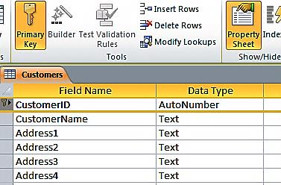
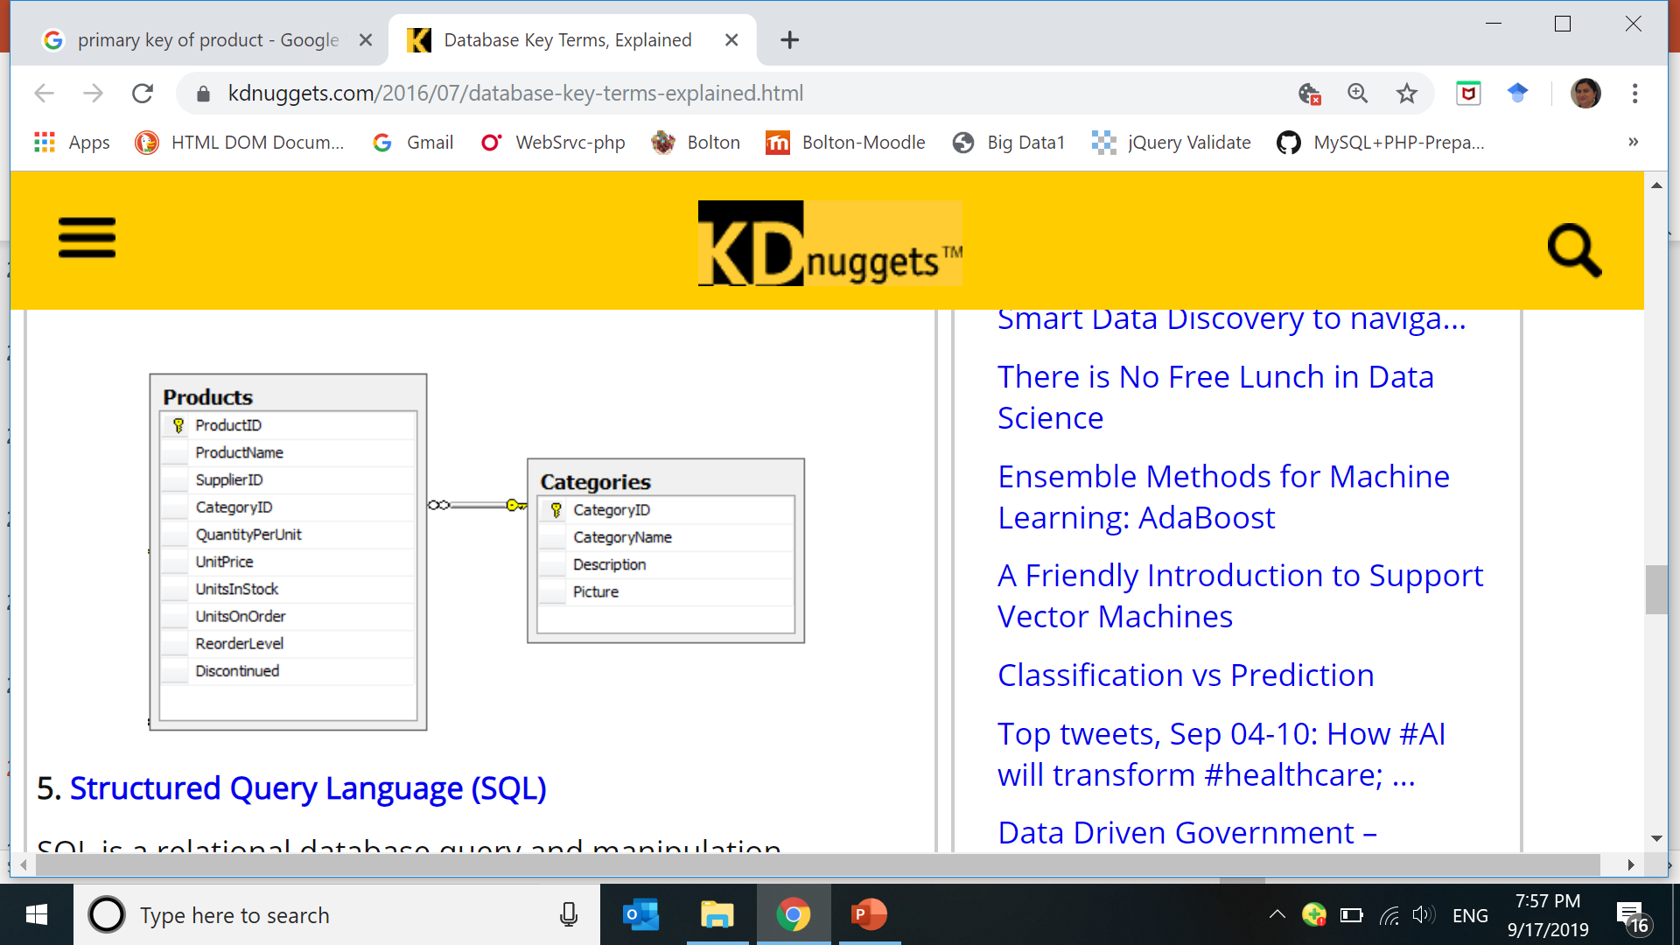
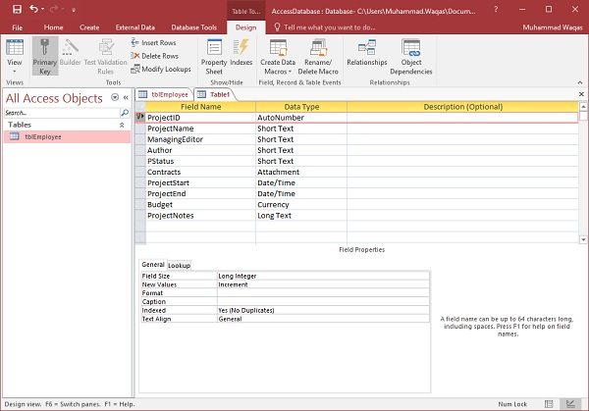
b. Primary Key
The primary key is chosen from a set of candidate keys.
Uniquely identify an instance.
uniquely identifies a row in each table.
Denoted by, PK.
Never has a NULL value.
Does Not change over time.
As short as possible.
Ex,
PK= EmpId or EmiratesID
EName, DOB ????
Notes:
https://supportcontent.ca.com/cadocs/0/CA%20ERwin%20%20Data%20Modeler%20r7%203%2010-ENU/Bookshelf_Files/HTML/ERwin%20Methods%20Guide/4229.html
https://www.tutorialspoint.com/ms_access/ms_access_create_tables.htm
https://www.kdnuggets.com/2016/07/database-key-terms-explained.html

Slide 25
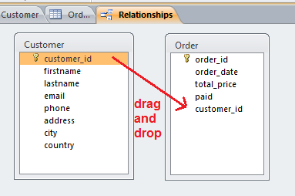
c. Foreign Key
A Foreign key is a:
key borrowed from another related table
(that’s why its foreign)
to make the relationship(connection) between two tables.
Denoted by FK.
Notes:
http://en.tekstenuitleg.net/articles/software/create-a-one-to-many-relationship-in-access

Slide 26
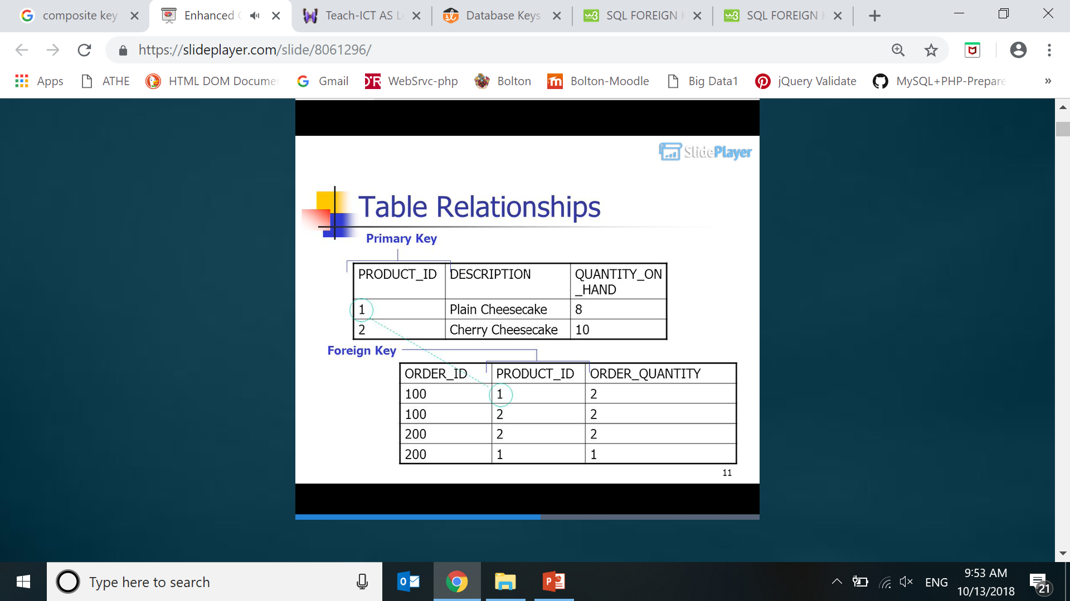
https://slideplayer.com/slide/8061296/

Slide 27
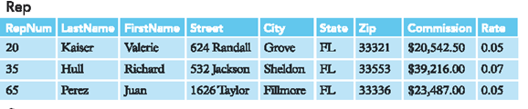
Examples from Premier Database – Primary Key
Repnum uniquely identifies the Rep table
and is the primary key of this table.

Slide 28
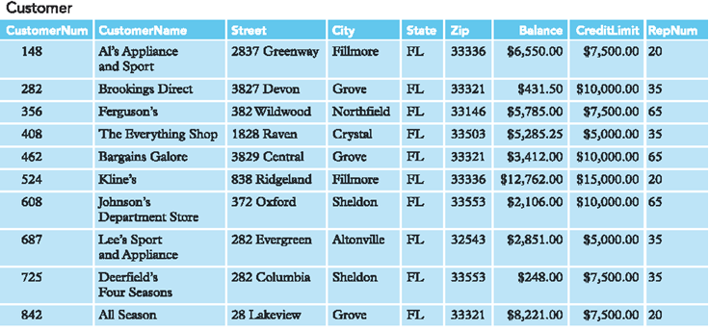
Ex: from Premier Database – Primary Key
Customernum uniquely identifies the Customer table
and is the primary key of this table.

Slide 29
Examples from Premier Database – Foreign Key
Repnum is a Foreign key borrowed from Rep table

Slide 30
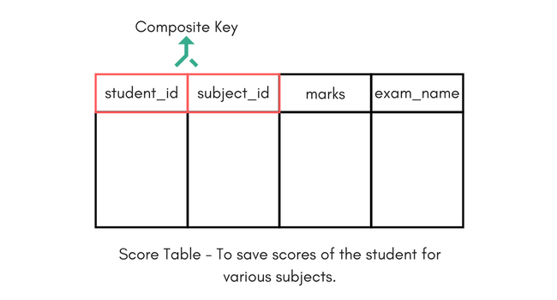
d. Composite Key
If we use multiple attributes
(more than one) attttribute
to create the Primary Key then
that Primary Key is called Composite Key
E.g. if we have used “Name, Address” as a Primary Key.
Notes:
https://www.studytonight.com/dbms/database-key.php

Slide 31
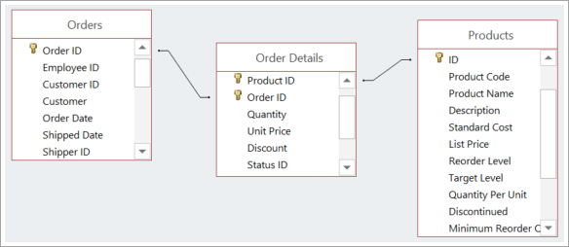
Notes:
https://support.office.com/en-us/article/video-create-many-to-many-relationships-e65bcc53-8e1c-444a-b4fb-1c0b8c1f5653

Slide 32
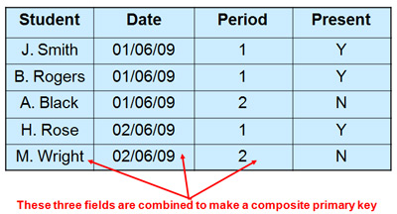
Intext Citation: (Tech-ICT, n.d.)
Bibliography:
Tech-ICT. (n.d.) Types of primary keys: Compound [Online] Available from: http://www.teach-ict.com/as_a2_ict_new/ocr/AS_G061/315_database_concepts/terminology/miniweb/pg11.htm . [Accessed 9 October 2018].

Slide 33
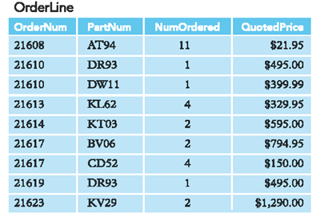
Ex: from Premier Database – Composite Key
Ordernum and Partnum makes up the primary key
Of the OrderLine table.
This is what is known as a Composite Primary key, that is,
primary key that is made up of more than one field.

Slide 34
Relationship Cardinalities
Relationship cardinalities or multiplicities
multiplicity –
number of possible occurrences of an entity that
may relate to a single occurrence of an associated
entity.
There are three common types:
ONE-TO-ONE (1:1)
ONE-TO-MANY (1:* OR 1:N)
MANY-TO-MANY (*:* OR N:M)

Slide 35
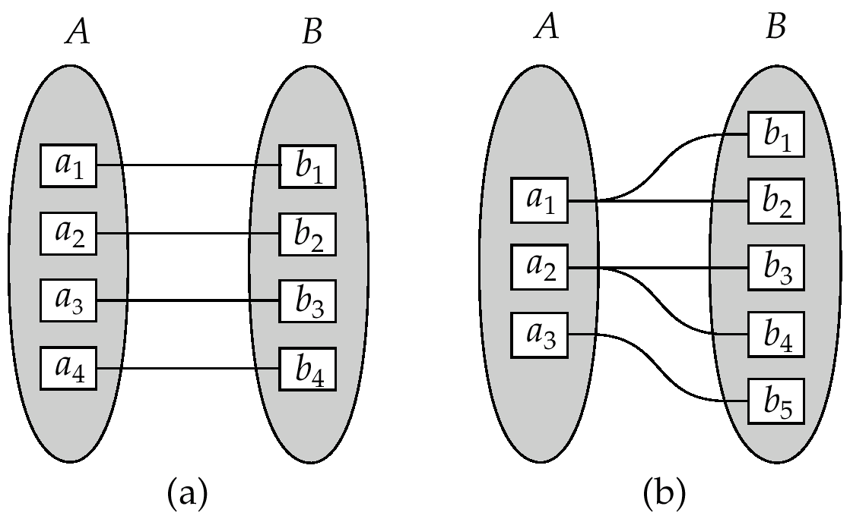
Mapping Cardinalities
One to one
One to many
Note: Some elements in A and B may not be mapped to any
elements in the other set

Slide 36
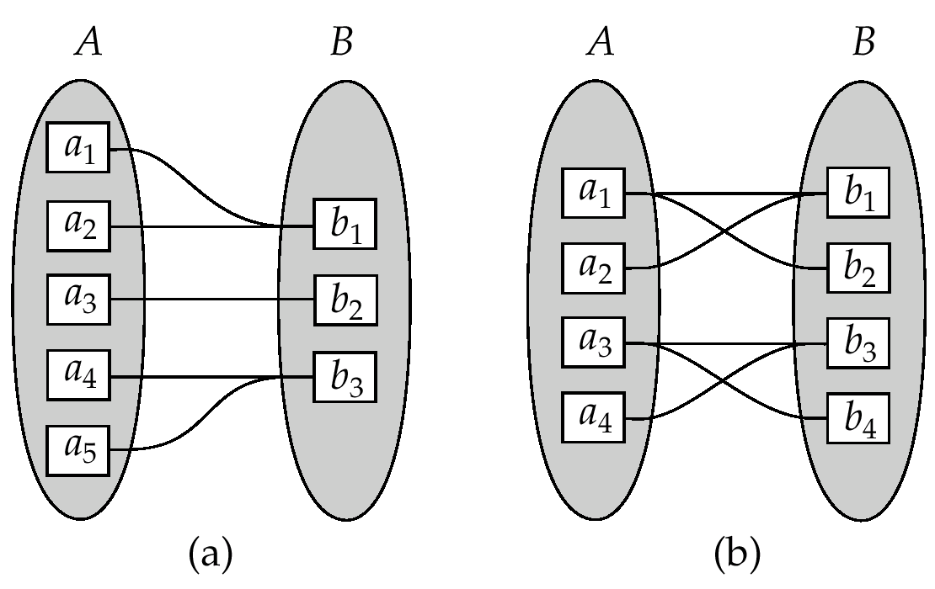
Mapping Cardinalities
Many to one
Many to many
Note: Some elements in A and B may not be mapped to any
elements in the other set

Slide 37

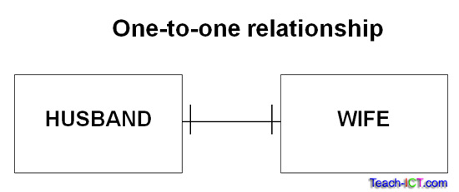
a. One-to-One Relationships
In a one-to-one relationship,
each instance of an entity class E1 can be associated with
at most one instance of another entity class E2
and vice versa.
Example: A department may have only one manager, and
a manager may manage only one department.

Slide 38
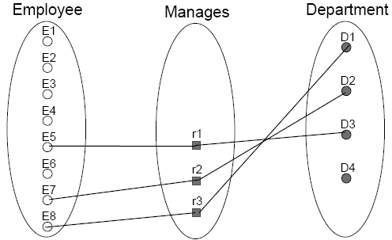
a. One-to-One Relationship Example
A department may have only one manager.
A manager (employee) may manage only one department.

Slide 39
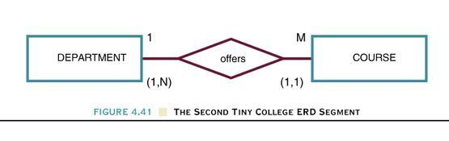
b. One-to-Many Relationships
each instance of an entity E1 can be associated with
more than one instance of another entity E2.
However, E2 can only be associated with
at most one instance of entity E1.
Example: A department offers many courses, but
a course is offered by only one department.

Slide 40
b. One-to-Many Relationship Example
A project may be associated with at most one department.
A department may have multiple projects.

Slide 41
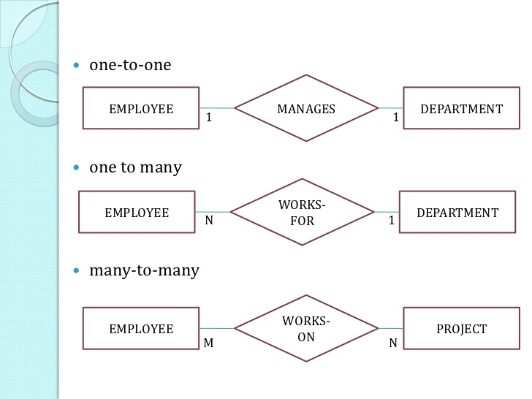
c. Many-to-Many Relationships
each instance of an entity E1 can be associated with
more than one instance of another entity E2
and vice versa.
Example: An employee may work on multiple projects, and
a project may have multiple employees working on it.

Slide 42
c. Many-to-Many Relationship Example

Slide 44
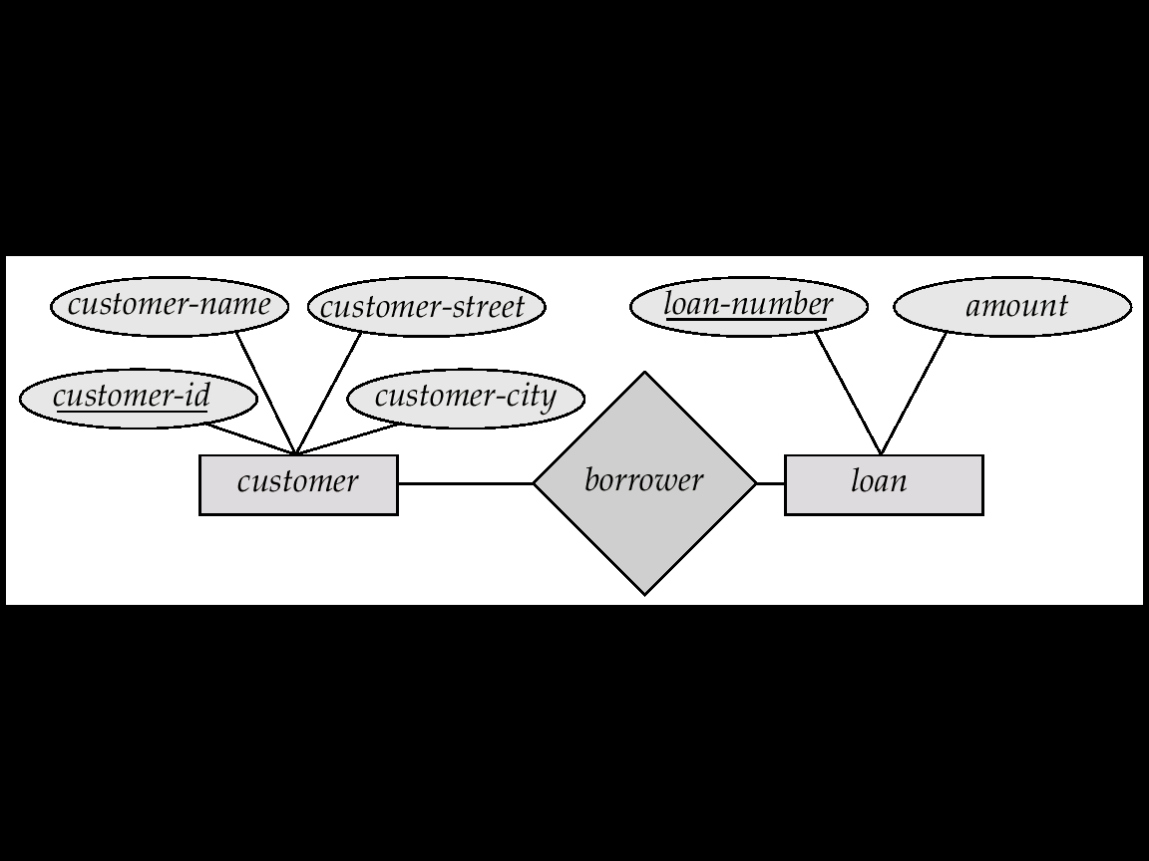
An Example

Slide 45
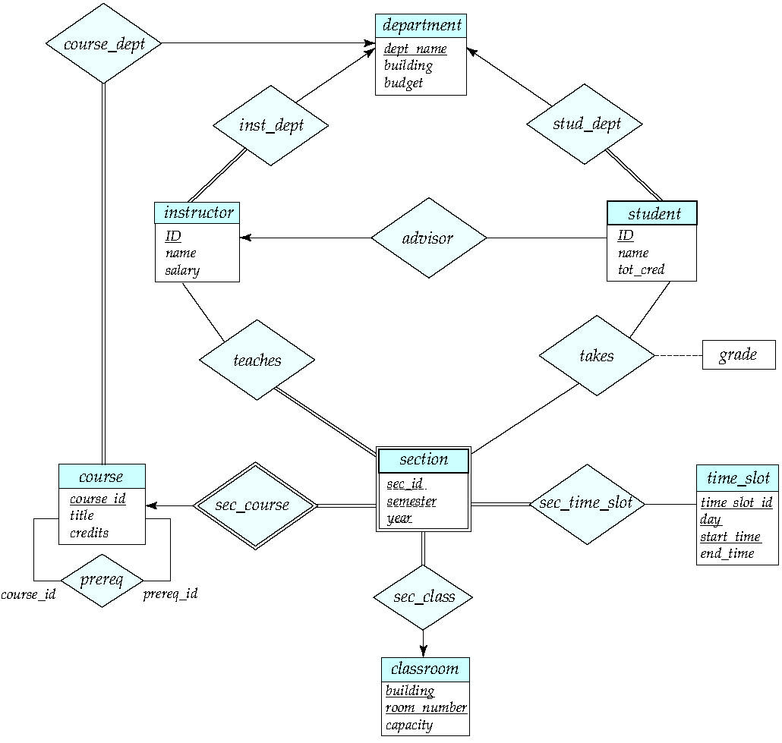
E-R Diagram for a University Enterprise

Slide 46
ER Design Question
Construct a university database where:
Each student has an id, name, birth date, and Grade /mark.
Each professor has a name and is in a department.
Each department offers courses and has professors. A department has a name and a building location.
Each course has a name and number and may have multiple sections.
Each section is taught by a professor and has a section number.
Students enroll in sections of courses. They may only enroll in a course once (and in a single section). Once a student completes a course, they receive a grade.

